Slide 1
Federal Income Tax
Check the one that applies. Likely “Single.”
Exactly as shown on your Form W2
Leave Blank For Now! Remember to fill in before sending.
Check with your parent/guardian to see if you were covered. If so, check this box
Check here if your parent/guardian claims you as a dependent on their taxes. Also, do the worksheet to see what your deduction amount is to enter on Line 8.
Optional
Current Address, not one listed on W2 if it has changed.

Slide 2
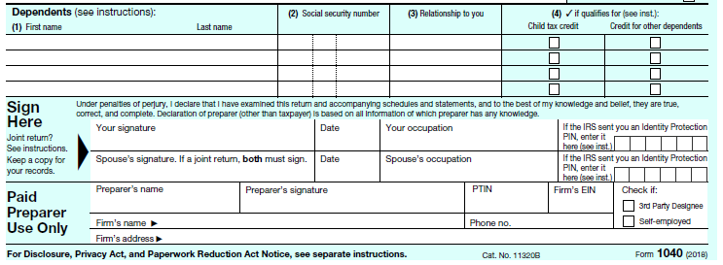
Fill out this section only if you have dependents. Most likely, you do not.
Sign your name in your very best cursive
Date
Your occupation is Student

Slide 3
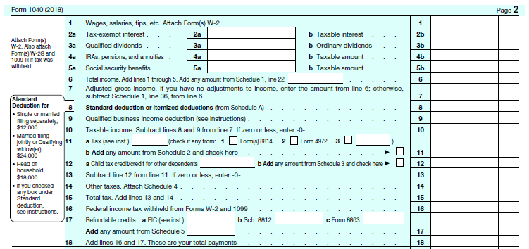
Federal Income Tax (page 2 of Form 1040)
From Box 1 of all forms W2. Make sure to include tips or other cash payments you received during the year.
Add Lines 1 Through 5 and put total here.
If you had no adjustments on lines 2-5, enter the amount from line 6 here.
Enter your standard deduction here.
This amount is found in the left margin of this form. If you can be claimed as a dependent, you need to fill out the worksheet to figure out line 8.
Subtract line 8 from 7. (Line 8 – Line 7) If zero or less enter zero here.
Use Line 10 above to find your tax on the tax table and fill it in on Line 11.
Line 11 – Line 12 = Line 13
Line 13 + Line 14 = Line 15
Enter amount from Box 2 of all forms W2
Line 16 + Line 17 = Line 18

Slide 4
IF LINE 18 > LINE 15:
Line 18 – Line 15 = Line 19
Use this section only if you want your refund directly deposited to your account.
Amount of Line 19 you want refunded to you. Likely ALL of it. Enter here. This is the amount of your refund.

Slide 5
Last Reminders…
1. Make sure to fill in your Social Security number before sending in return.
2. If mailing your return, use one of these addresses:
Receiving a Refund
Sending a Check
Department of the Treasury
Internal Revenue Service
Fresno, CA 93888-0014
Internal Revenue Service P.O. Box 802501
Cincinnati, OH 45280-2501
3. Save copies of your Federal return. You will need one for your own records and one to send in with your State tax filing.
4. Make sure to send the correct copy of each of your forms W2 with your return.
5. If you choose to E-File your return, use this link: Free File Options

Slide 6
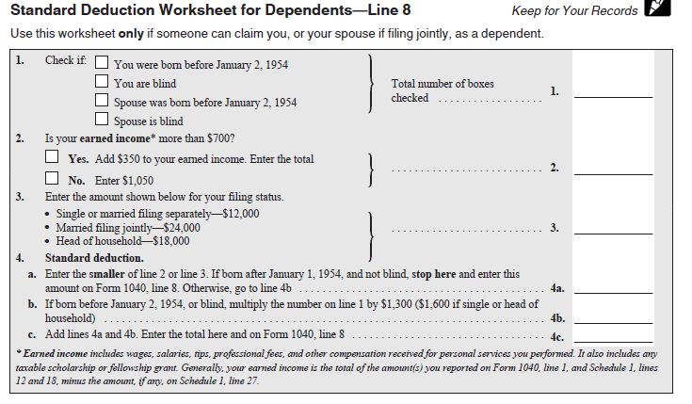
If you someone can claim you as a dependent, you must figure your deduction using the following worksheet.
Earned income is on Line 1 of Form 1040. Check your earned income versus $700 and check the appropriate box. Follow the instructions for the box selected.
Enter amount for your filing status. Likely $12000.
Enter the smaller of line 2 or 3 here.
Enter this amount on Line 8 above
Click here to return to Slide 1

Slide 7
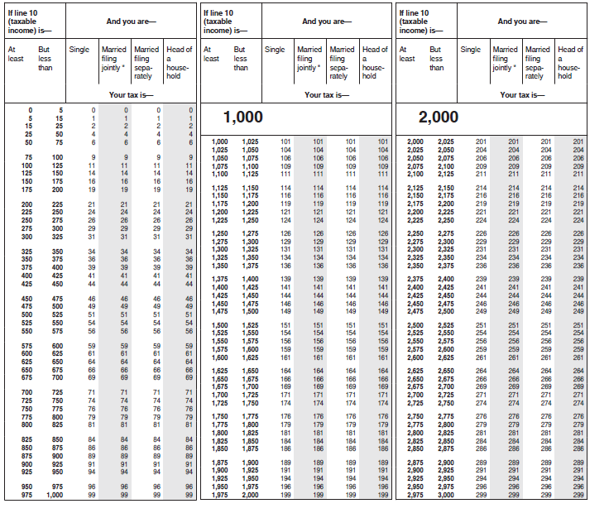
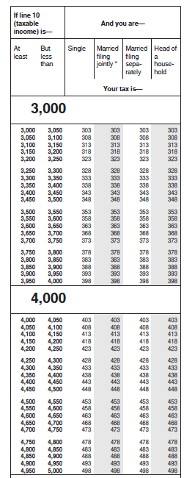
Use Line 10 above to find your tax on this table and fill it in on Line 11 above.
If Line 6 is more than $4000, please ask for help.
Back to Slide 3.

